Slide 1
Main page

Slide 2
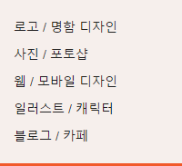
The category area should contain a shadow. (Drop shadows, not inner shadows)
I will resend the Svg file to the white version.
Please reduce the category area font size to 1.2em. Thickness is medium.
Please use 'Noto Sans CJK KR' font. (All fonts on the site are this)
Please reduce font size to 1em
Make sure the section is centered.

Slide 3
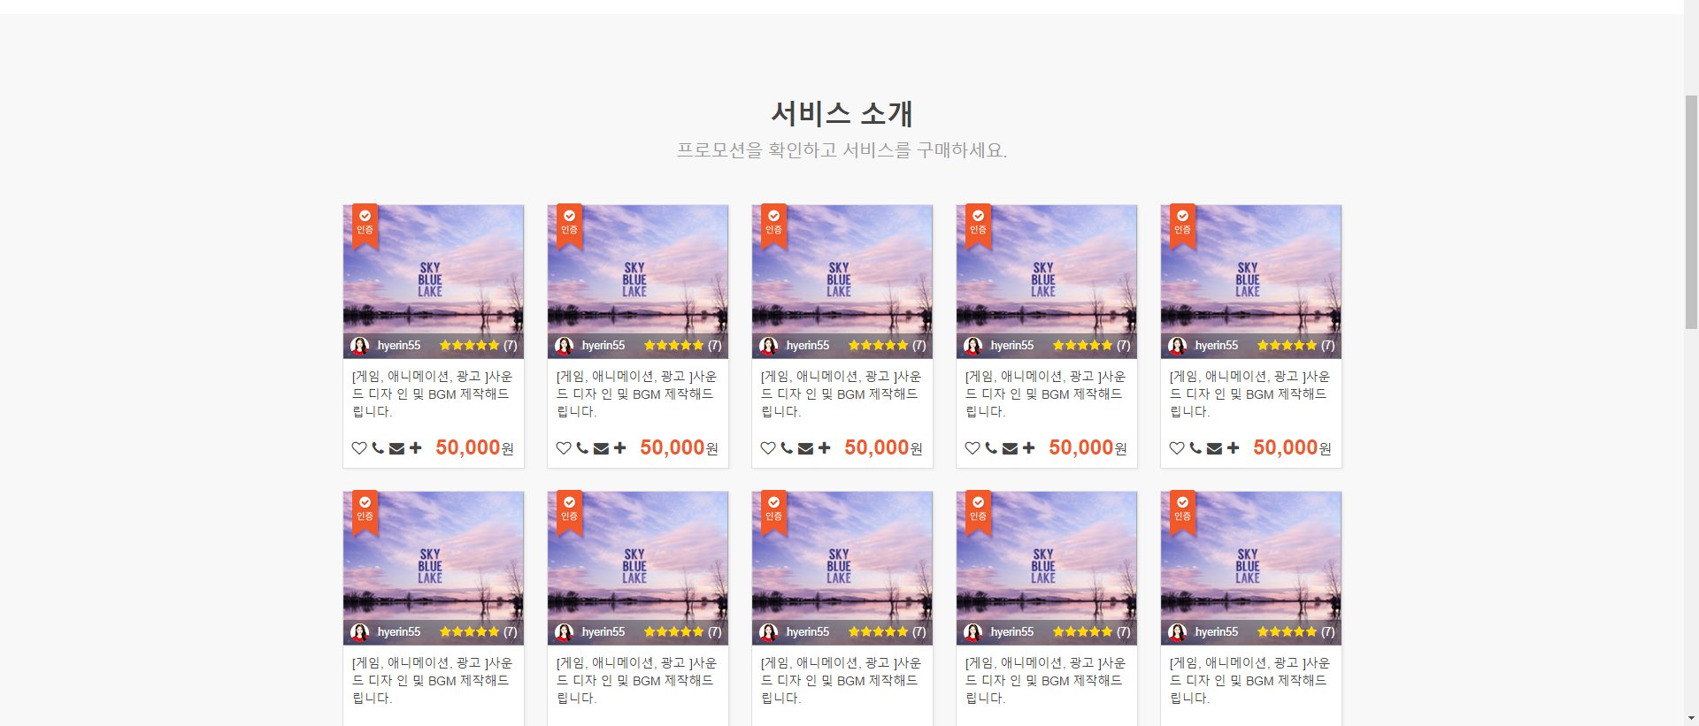
Please set the top bar to come along when scrolling down (sticky)

Slide 4
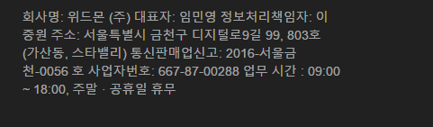
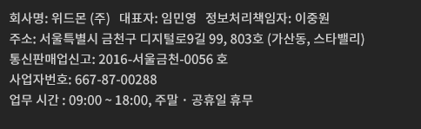
This should be the same text layout as this one.

Slide 5
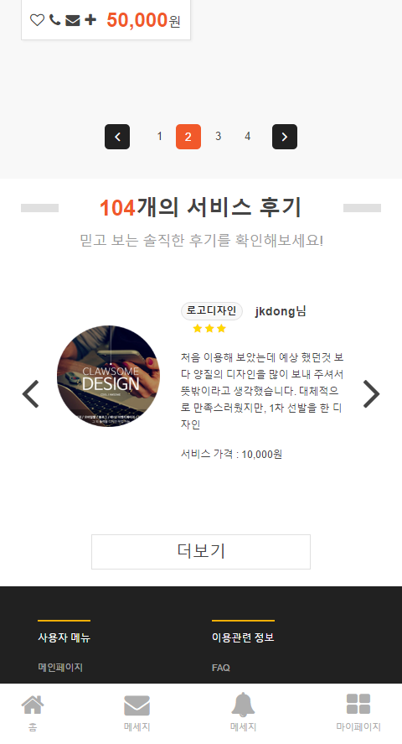
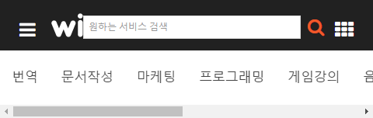
When the search area is activated, the logo should disappear and a full white area should appear.
It's too close to footer. Please raise a little.
The size of the icon is small. Please visually match the size of the message icon

Slide 6
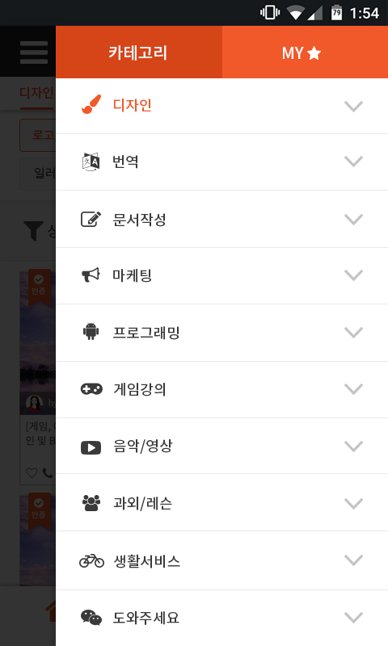
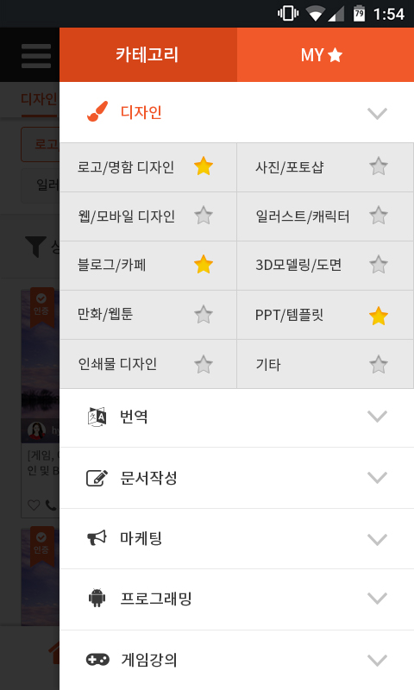
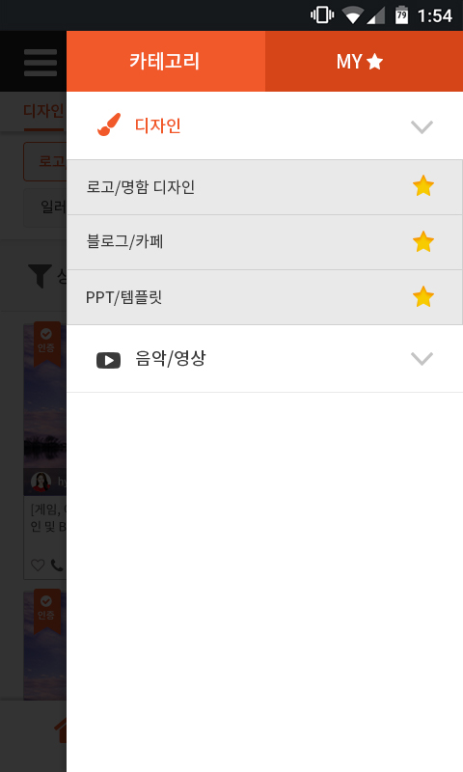
Tab design.
Let me design this on mobile.
When you touch a star for the first time, it changes to yellow, and once again, it becomes inactive.
When you touch a star, it is immediately removed from my list.

Slide 7
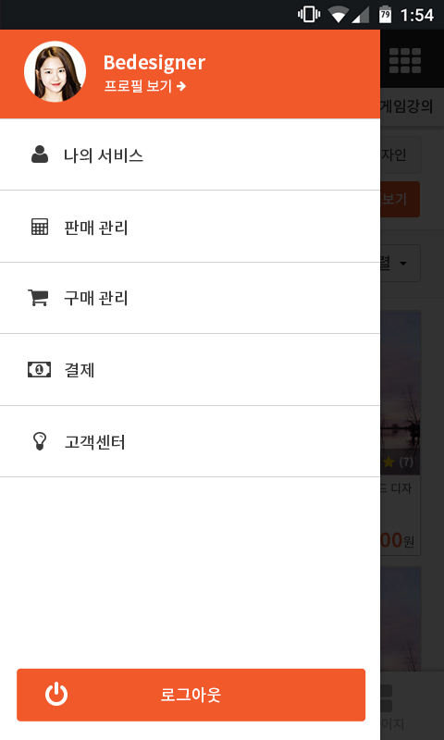
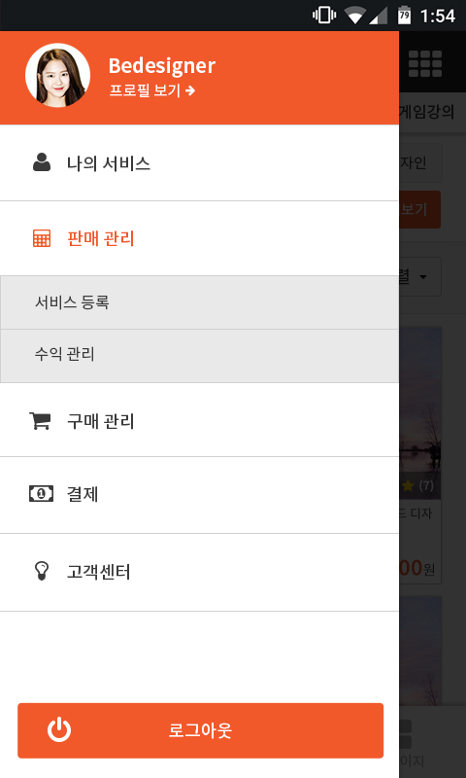
Touchable

